Slide 1
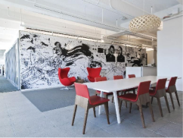

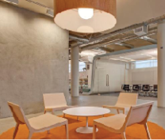
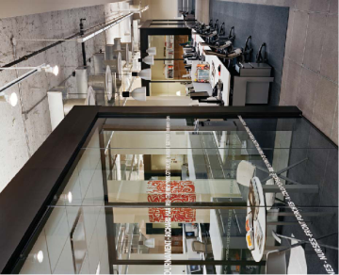

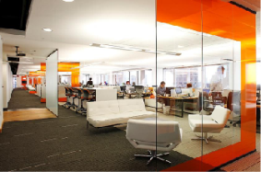
C team
- Jim, Cho, Tom, Lina, Missy
2 Week presentation
Qualcomm Institute

Slide 2
2 week presentation
CONTENTS
C team
Sequence
Diagram
ER
Diagram
Web
Client
Application
Qualcomm Institute

Slide 3
Sequence Diagram
C team
Qualcomm Institute

Slide 4
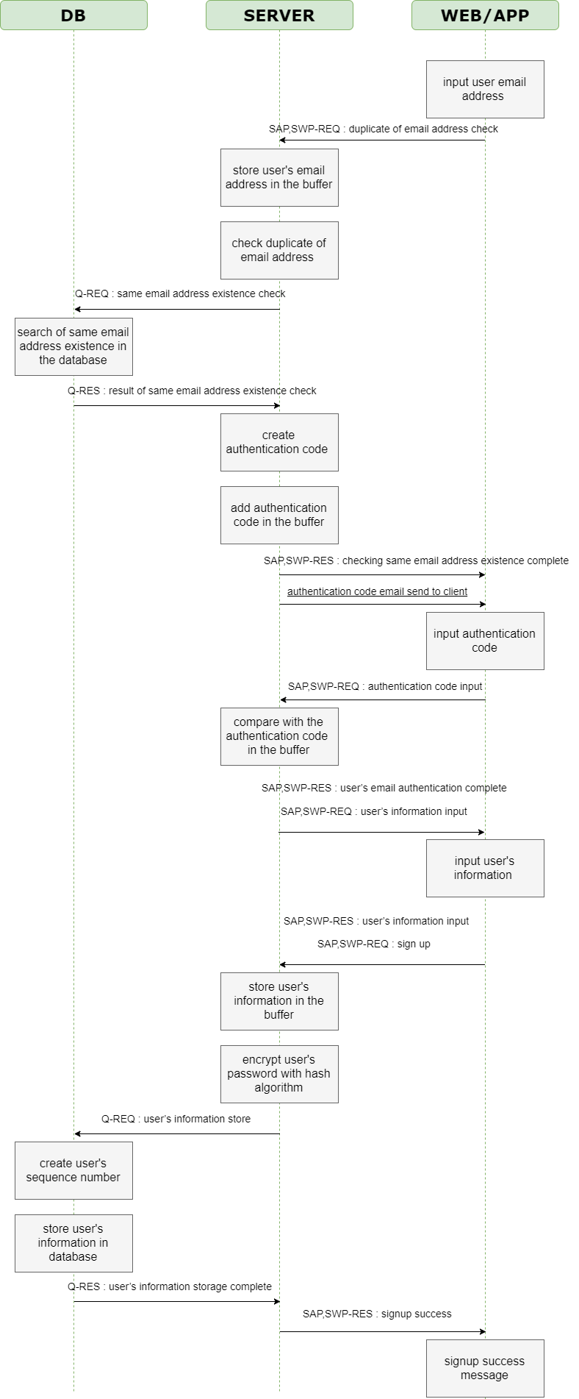
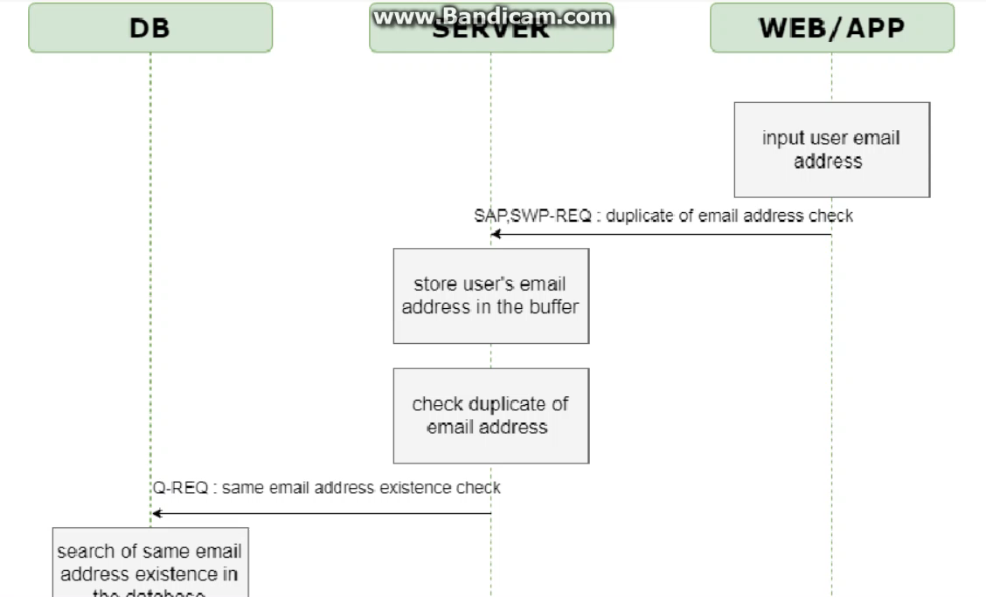
Registration Sequence Diagram
C team

Slide 5
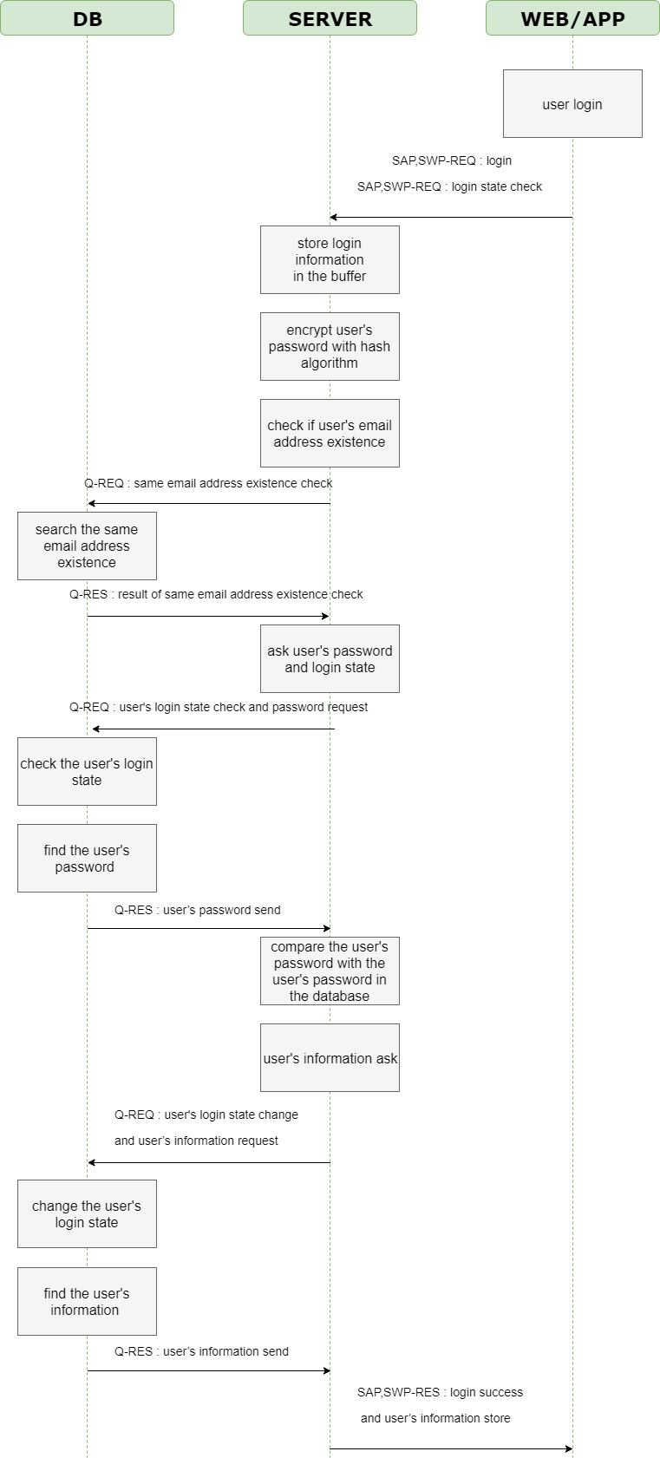
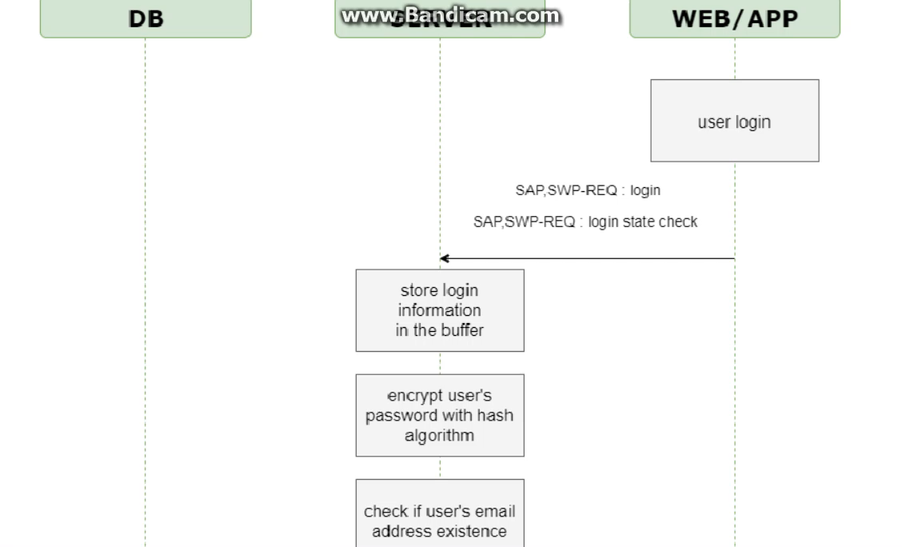
Sign-in Sequence Diagram
C team

Slide 6
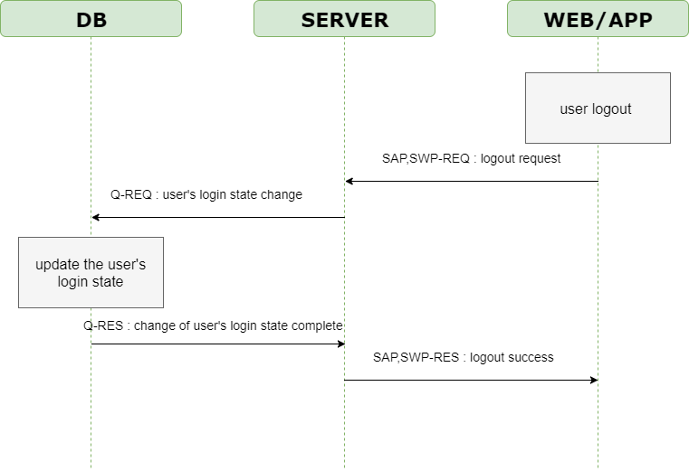
Sign-out Sequence Diagram
C team

Slide 7
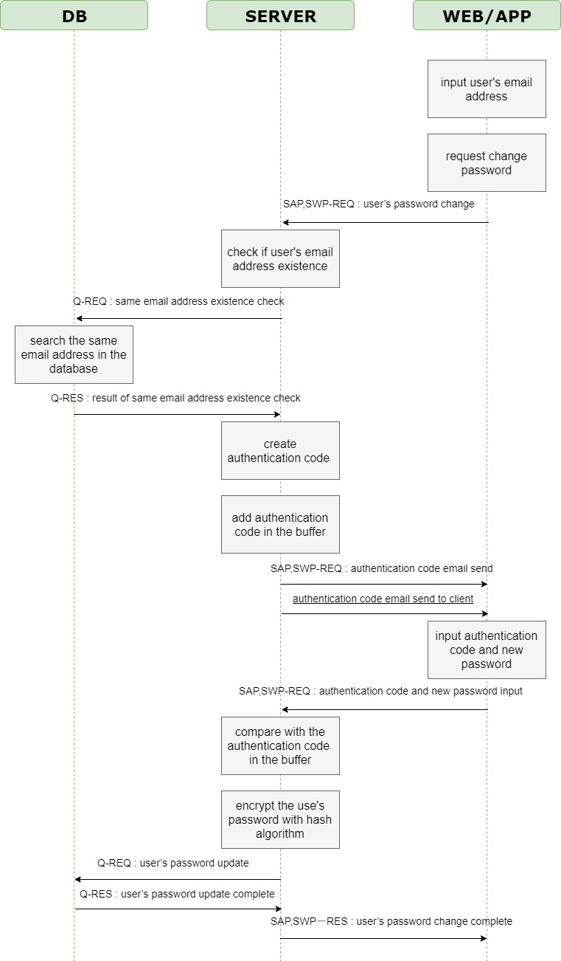
Forgotten password Sequence Diagram
C team

Slide 8
Change point of Sequence Diagram
C team
Delete duplicate information
Change authentication method in forgotten password situation
Change expression
Notes:
비밀번호 변경 방법이 이메일 인증에서 인증 코드로 바뀜
영어 표현 변경
중복 설명 제거

Slide 9
ER Diagram
C team
Qualcomm Institute

Slide 10
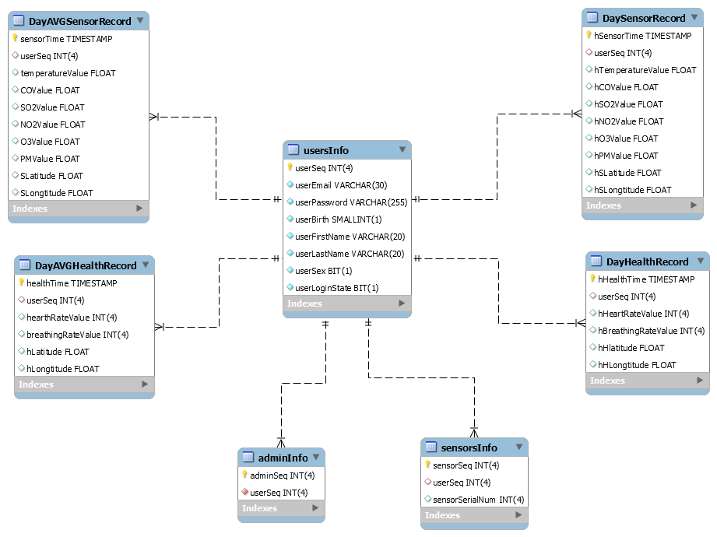
ER Diagram
C team

Slide 11
Web Client
C team
Qualcomm Institute

Slide 12
Web client
C team

Slide 13
Application UI
C team
Qualcomm Institute

Slide 14
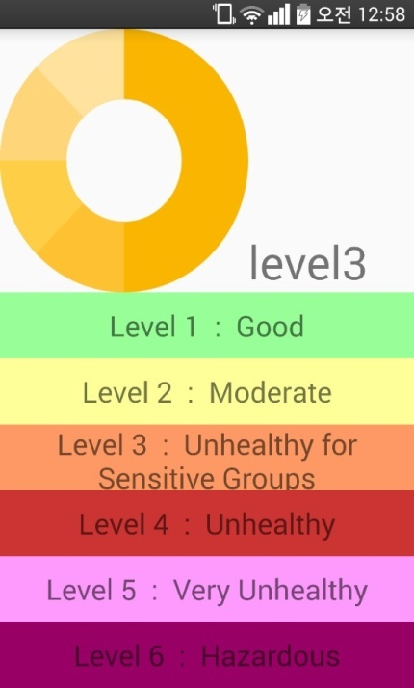
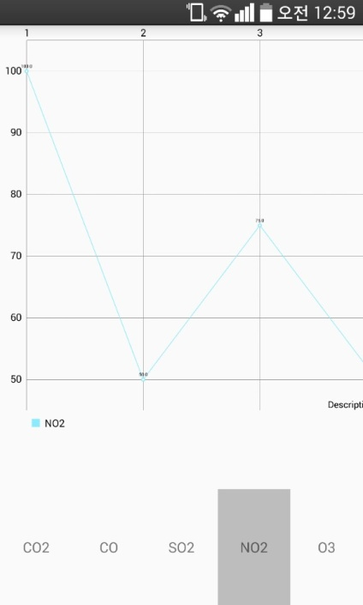
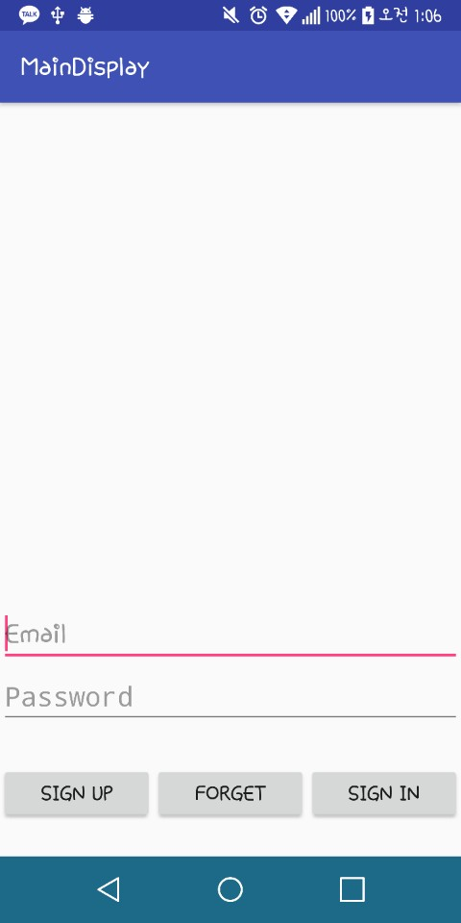
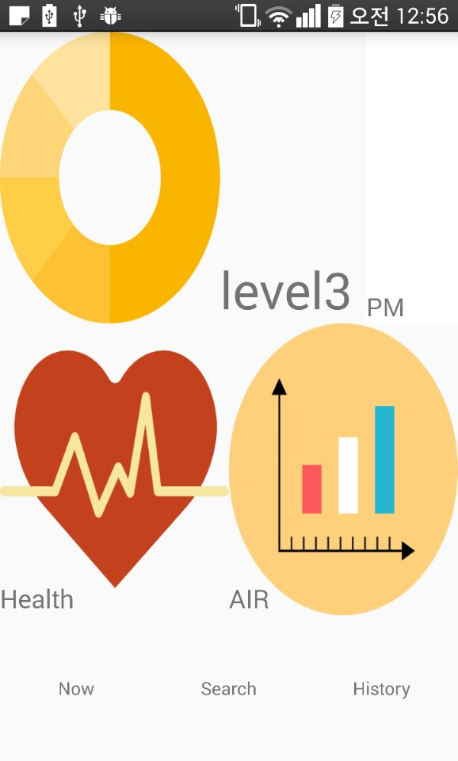
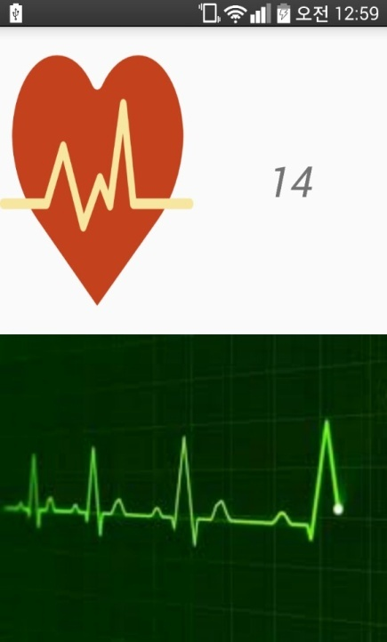
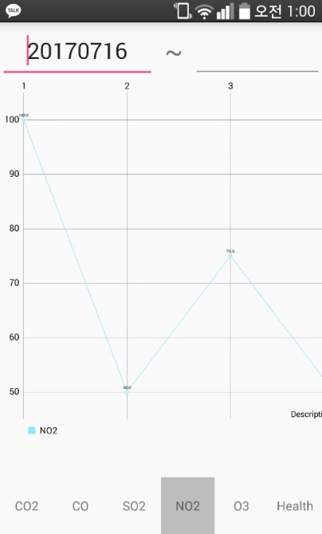
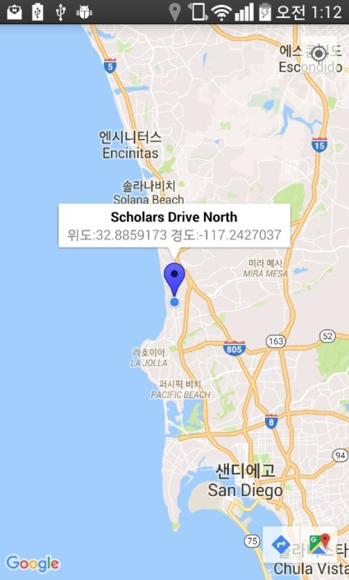
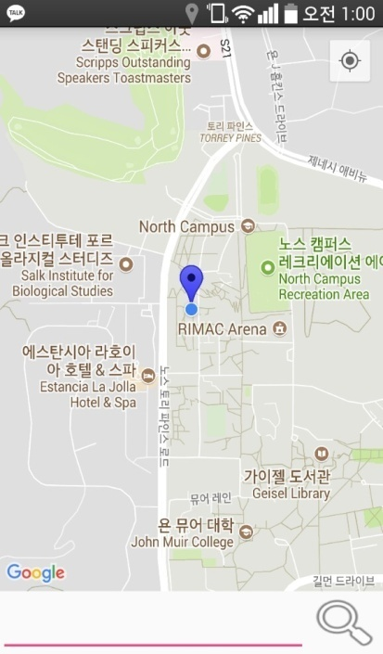
Application UI
C team

Slide 15
Application Activity Function
C team
Sign-Up
1. Confirm duplicate of user’s email
2. Certificate user’s email
3. Reconfirm Password
4. Give Unique Sequence number
5. Information about User
- Name(First, Last), Birth, Gender, E-mail, PW
6. Select notification Service

Slide 16
Application Activity Function
C team
Sign-In
Change email to Sequence number
Reset the passwords
Find Email
Graph
Health
Home Activity
1. Show the heart rate graph
2. Display the breathing rate per minute

Slide 17
Application Activity Function
C team
Map
1. Display current position on google map
2. Display the real-time air density
3. Search the location on google map
Air Density
Graphing & Display the real-time air density
Figure the AQI value (Pie Graph)
Display history of sensor data by date

Slide 18
Thank you
Qualcomm Institute

